Slide 1







Slide 2


PlantUML in Action
000
Opening and Introduction
Yasen – Enterprise Architecture
YouTube: @yasenzhao

Slide 3

PlantUML in Action
001
PlantUML Quick Starts
Utilizing a simple and intuitive language, users can effortlessly draft various types of diagrams.
Yasen – Enterprise Architecture
YouTube: @yasenzhao

Slide 4


PlantUML in Action
002
1. Sequence Diagram
1.1 Basic Examples
Yasen – Enterprise Architecture
YouTube: @yasenzhao

Slide 5


PlantUML in Action
003
1. Sequence Diagram
1.2 Declaring Participant
1.3 Declaring Participant on Multiline
Yasen – Enterprise Architecture
YouTube: @yasenzhao

Slide 6




PlantUML in Action
004
1. Sequence Diagram
1.4 Use Non-Letters in Participants
1.5 Message to Self
1.6 Text Alignment
Yasen – Enterprise Architecture
YouTube: @yasenzhao

Slide 7



PlantUML in Action
005
1. Sequence Diagram
1.7 Change Arrow Style
1.8 Change Arrow Color
Yasen – Enterprise Architecture
YouTube: @yasenzhao

Slide 8


PlantUML in Action
006
1. Sequence Diagram
1.9 Message Sequence Numbering
Yasen – Enterprise Architecture
YouTube: @yasenzhao

Slide 9


PlantUML in Action
007
1. Sequence Diagram
1.10 Page Title, Header and Footer
Yasen – Enterprise Architecture
YouTube: @yasenzhao

Slide 10

PlantUML in Action
008
1. Sequence Diagram
1.11 Splitting Diagrams
Yasen – Enterprise Architecture
YouTube: @yasenzhao

Slide 11


PlantUML in Action
009
1. Sequence Diagram
1.12 Grouping Message
Yasen – Enterprise Architecture
YouTube: @yasenzhao

Slide 12


PlantUML in Action
010
1. Sequence Diagram
1.13 Secondary Group Label
Yasen – Enterprise Architecture
YouTube: @yasenzhao

Slide 13


PlantUML in Action
011
1. Sequence Diagram
1.14 Notes on Messages
Yasen – Enterprise Architecture
YouTube: @yasenzhao

Slide 14


PlantUML in Action
012
1. Sequence Diagram
1.15 Some Other Notes
Yasen – Enterprise Architecture
YouTube: @yasenzhao

Slide 15


PlantUML in Action
013
1. Sequence Diagram
1.16 Changing Notes Shape
Yasen – Enterprise Architecture
YouTube: @yasenzhao

Slide 16


PlantUML in Action
014
1. Sequence Diagram
1.17 Note over all Participants
Yasen – Enterprise Architecture
YouTube: @yasenzhao

Slide 17



PlantUML in Action
015
1. Sequence Diagram
1.18 Several Notes aligned at the Same Level
Yasen – Enterprise Architecture
YouTube: @yasenzhao

Slide 18


PlantUML in Action
016
1. Sequence Diagram
1.19 Creole and HTML
Yasen – Enterprise Architecture
YouTube: @yasenzhao

Slide 19



PlantUML in Action
017
1. Sequence Diagram
1.20 Divider or Separator 1.21 Reference
Yasen – Enterprise Architecture
YouTube: @yasenzhao

Slide 20

PlantUML in Action
018
1. Sequence Diagram
1.22 Delay 1.23 Text Wrapping 1.24 Space
Yasen – Enterprise Architecture
YouTube: @yasenzhao

Slide 21



PlantUML in Action
019
1. Sequence Diagram
1.25 Lifeline Activation and Destruction
1.26 Return
Yasen – Enterprise Architecture
YouTube: @yasenzhao

Slide 22


PlantUML in Action
020
1. Sequence Diagram
1.27 Participant Creation
Yasen – Enterprise Architecture
YouTube: @yasenzhao

Slide 23



PlantUML in Action
021
1. Sequence Diagram
1.28 Shortcut Syntax
Yasen – Enterprise Architecture
YouTube: @yasenzhao

Slide 24



PlantUML in Action
022
1. Sequence Diagram
1.29 Incoming and Outgoing Messages
Yasen – Enterprise Architecture
YouTube: @yasenzhao

Slide 25


PlantUML in Action
023
1. Sequence Diagram
1.30 Short Arrows
Yasen – Enterprise Architecture
YouTube: @yasenzhao

Slide 26


PlantUML in Action
024
1. Sequence Diagram
1.31 Anchors and Duration
Yasen – Enterprise Architecture
YouTube: @yasenzhao

Slide 27


PlantUML in Action
025
1. Sequence Diagram
1.32 Stereotypes and Spots
Yasen – Enterprise Architecture
YouTube: @yasenzhao

Slide 28

PlantUML in Action
026
1. Sequence Diagram
1.33 More Information on Titles
Yasen – Enterprise Architecture
YouTube: @yasenzhao

Slide 29



PlantUML in Action
027
1. Sequence Diagram
1.34 Participants Encompass
1.35 Removing Foot Boxes
Yasen – Enterprise Architecture
YouTube: @yasenzhao

Slide 30



PlantUML in Action
028
1. Sequence Diagram
1.36 Skinparam
Yasen – Enterprise Architecture
YouTube: @yasenzhao

Slide 31


PlantUML in Action
029
1. Sequence Diagram
1.37 Changing Padding
Yasen – Enterprise Architecture
YouTube: @yasenzhao

Slide 32


PlantUML in Action
030
1. Sequence Diagram
1.38 Appendix: Arrow Types
Yasen – Enterprise Architecture
YouTube: @yasenzhao

Slide 33

PlantUML in Action
031
1. Sequence Diagram
1.39 Specific SkinParameter
Yasen – Enterprise Architecture
YouTube: @yasenzhao

Slide 34



PlantUML in Action
032
1. Sequence Diagram
1.40 Hide Unlinked Participant
Yasen – Enterprise Architecture
YouTube: @yasenzhao

Slide 35


PlantUML in Action
033
1. Sequence Diagram
1.41 Color a Group Message
Yasen – Enterprise Architecture
YouTube: @yasenzhao

Slide 36



PlantUML in Action
034
1. Sequence Diagram
1.42 Mainframe 1.43 Slanted or Odd Arrows
Yasen – Enterprise Architecture
YouTube: @yasenzhao

Slide 37



PlantUML in Action
035
2. Use Case Diagram
2.1 Use Cases 2.2 Actors
Yasen – Enterprise Architecture
YouTube: @yasenzhao

Slide 38


Slide 39


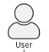

PlantUML in Action
036
2. Use Case Diagram
2.3 Change Actor Style
Yasen – Enterprise Architecture
YouTube: @yasenzhao

Slide 40


PlantUML in Action
037
2. Use Case Diagram
2.4 Usecases Description
Yasen – Enterprise Architecture
YouTube: @yasenzhao

Slide 41


PlantUML in Action
038
2. Use Case Diagram
2.5 Use Package
Yasen – Enterprise Architecture
YouTube: @yasenzhao

Slide 42


PlantUML in Action
039
2. Use Case Diagram
2.6 Basic Example for Use Case
Yasen – Enterprise Architecture
YouTube: @yasenzhao

Slide 43


PlantUML in Action
040
2. Use Case Diagram
2.7 Extension
Yasen – Enterprise Architecture
YouTube: @yasenzhao

Slide 44


PlantUML in Action
041
2. Use Case Diagram
2.8 Using notes in Use Case
Yasen – Enterprise Architecture
YouTube: @yasenzhao

Slide 45


PlantUML in Action
042
2. Use Case Diagram
2.9 Stereotypes
Yasen – Enterprise Architecture
YouTube: @yasenzhao

Slide 46


PlantUML in Action
043
2. Use Case Diagram
2.10 Changing Arrow Direction
Yasen – Enterprise Architecture
YouTube: @yasenzhao

Slide 47

PlantUML in Action
044
2. Use Case Diagram
2.11 Spitting Diagrams 2.12 Diagram Direction
Yasen – Enterprise Architecture
YouTube: @yasenzhao

Slide 48


PlantUML in Action
045
2. Use Case Diagram
2.13 Skinparam
Yasen – Enterprise Architecture
YouTube: @yasenzhao

Slide 49


PlantUML in Action
046
2. Use Case Diagram
2.14 Complete Example
Yasen – Enterprise Architecture
YouTube: @yasenzhao

Slide 50



PlantUML in Action
047
2. Use Case Diagram
2.15 Business Use Case
Yasen – Enterprise Architecture
YouTube: @yasenzhao

Slide 51


PlantUML in Action
048
2. Use Case Diagram
2.16 Change Arrow Color and Style (Inline)
Yasen – Enterprise Architecture
YouTube: @yasenzhao

Slide 52


PlantUML in Action
049
2. Use Case Diagram
2.17 Change Element Color and Style (Inline)
Yasen – Enterprise Architecture
YouTube: @yasenzhao

Slide 53


PlantUML in Action
050
2. Use Case Diagram
2.18 Display JSON Data on Use Case Diagram
Yasen – Enterprise Architecture
YouTube: @yasenzhao

Slide 54


PlantUML in Action
051
3. Class Diagram
3.01 Declaring Element
Yasen – Enterprise Architecture
YouTube: @yasenzhao

Slide 55


PlantUML in Action
052
3. Class Diagram
3.02 Relations between Classes
Yasen – Enterprise Architecture
YouTube: @yasenzhao

Slide 56


PlantUML in Action
053
3. Class Diagram
3.03 Lebel on Relations
Yasen – Enterprise Architecture
YouTube: @yasenzhao

Slide 57


PlantUML in Action
054
3. Class Diagram
3.04 Using Non-Letters in Element Names and Relation Labels
Yasen – Enterprise Architecture
YouTube: @yasenzhao

Slide 58


PlantUML in Action
055
3. Class Diagram
3.05 Adding Properties and Methods
Yasen – Enterprise Architecture
YouTube: @yasenzhao

Slide 59

PlantUML in Action
056
3. Class Diagram
A Real Example: Customer Shopping
https://landing.moqups.com/img/content/diagrams/uml-diagrams/uml-class-diagram/uml-class-1600.png
Yasen – Enterprise Architecture
YouTube: @yasenzhao

Slide 60


PlantUML in Action
057
3. Class Diagram
3.06 Defining Visibility
Yasen – Enterprise Architecture
YouTube: @yasenzhao

Slide 61


PlantUML in Action
058
3. Class Diagram
3.07 Abstract and Static Method
Yasen – Enterprise Architecture
YouTube: @yasenzhao

Slide 62


PlantUML in Action
059
3. Class Diagram
3.08 Advanced Class Body
Yasen – Enterprise Architecture
YouTube: @yasenzhao

Slide 63


PlantUML in Action
060
3. Class Diagram
3.09 Notes and Stereotypes
Yasen – Enterprise Architecture
YouTube: @yasenzhao

Slide 64


PlantUML in Action
061
3. Class Diagram
3.10 More on Notes
Yasen – Enterprise Architecture
YouTube: @yasenzhao

Slide 65


PlantUML in Action
062
3. Class Diagram
3.11 Note on Field or Method
Yasen – Enterprise Architecture
YouTube: @yasenzhao

Slide 66


PlantUML in Action
063
3. Class Diagram
3.12 Note on Links
Yasen – Enterprise Architecture
YouTube: @yasenzhao

Slide 67


PlantUML in Action
064
3. Class Diagram
3.13 Abstract Class and Interface
Yasen – Enterprise Architecture
YouTube: @yasenzhao

Slide 68

PlantUML in Action
065
3. Class Diagram
3.14 Hide Attributes, Methods…
Yasen – Enterprise Architecture
YouTube: @yasenzhao

Slide 69

PlantUML in Action
066
3. Class Diagram
3.15 Hide Classes & 3.16 Remove Classes
Yasen – Enterprise Architecture
YouTube: @yasenzhao

Slide 70


PlantUML in Action
067
3. Class Diagram
3.17 Hide, Remove or Restore Tagged Element or Wildcard
Yasen – Enterprise Architecture
YouTube: @yasenzhao

Slide 71

PlantUML in Action
068
3. Class Diagram
3.18 Hide or Remove Unlinked Class
Yasen – Enterprise Architecture
YouTube: @yasenzhao

Slide 72


PlantUML in Action
069
3. Class Diagram
3.19 Use Generics
Yasen – Enterprise Architecture
YouTube: @yasenzhao

Slide 73

PlantUML in Action
070
3. Class Diagram
3.20 Specific Spot
Yasen – Enterprise Architecture
YouTube: @yasenzhao

Slide 74


PlantUML in Action
071
3. Class Diagram
3.21 Packages
Yasen – Enterprise Architecture
YouTube: @yasenzhao

Slide 75


PlantUML in Action
072
3. Class Diagram
3.22 Packages Style 3.23 Namespaces
Yasen – Enterprise Architecture
YouTube: @yasenzhao

Slide 76


PlantUML in Action
073
3. Class Diagram
3.24 Automatic Package Creation
Yasen – Enterprise Architecture
YouTube: @yasenzhao

Slide 77


PlantUML in Action
074
3. Class Diagram
3.25 Lollipop Interface
Yasen – Enterprise Architecture
YouTube: @yasenzhao

Slide 78


PlantUML in Action
075
3. Class Diagram
3.26 Changing Arrows Orientation
Yasen – Enterprise Architecture
YouTube: @yasenzhao

Slide 79


PlantUML in Action
076
3. Class Diagram
3.27 Association Classes
Yasen – Enterprise Architecture
YouTube: @yasenzhao

Slide 80


PlantUML in Action
077
3. Class Diagram
3.28 Association on Same Class
Yasen – Enterprise Architecture
YouTube: @yasenzhao

Slide 81


PlantUML in Action
078
3. Class Diagram
3.29 Skinparam
Yasen – Enterprise Architecture
YouTube: @yasenzhao

Slide 82


PlantUML in Action
079
3. Class Diagram
3.30 Skinned Stereotypes
Yasen – Enterprise Architecture
YouTube: @yasenzhao

Slide 83


PlantUML in Action
080
3. Class Diagram
3.31 Color Gradient
Yasen – Enterprise Architecture
YouTube: @yasenzhao

Slide 84


PlantUML in Action
081
3. Class Diagram
3.32 Help on Layout
Yasen – Enterprise Architecture
YouTube: @yasenzhao

Slide 85


PlantUML in Action
082
3. Class Diagram
3.33 Splitting Large Files
Yasen – Enterprise Architecture
YouTube: @yasenzhao

Slide 86
PlantUML in Action
083
3. Class Diagram
3.33 Splitting Large Files (fix)
Yasen – Enterprise Architecture
YouTube: @yasenzhao

Slide 87


PlantUML in Action
084
3. Class Diagram
3.34 Extends and Implements
Yasen – Enterprise Architecture
YouTube: @yasenzhao

Slide 88


PlantUML in Action
085
3. Class Diagram
3.35 Bracketed Relations Style
Yasen – Enterprise Architecture
YouTube: @yasenzhao

Slide 89


PlantUML in Action
086
3. Class Diagram
3.36 Change Relation Color and Style
Yasen – Enterprise Architecture
YouTube: @yasenzhao

Slide 90


PlantUML in Action
087
3. Class Diagram
3.37 Change Class Color and Style
Yasen – Enterprise Architecture
YouTube: @yasenzhao

Slide 91


PlantUML in Action
088
3. Class Diagram
3.38 Arrow From/To Class Members
Yasen – Enterprise Architecture
YouTube: @yasenzhao

Slide 92


PlantUML in Action
089
3. Class Diagram
3.39 Grouping Inheritance Arrow Heads
Yasen – Enterprise Architecture
YouTube: @yasenzhao

Slide 93


PlantUML in Action
090
3. Class Diagram
3.40 Display JSON Data on Class or Object Diagram
Yasen – Enterprise Architecture
YouTube: @yasenzhao

Slide 94


PlantUML in Action
091
3. Class Diagram
3.41 Packages and Namespaces Enhancement
Yasen – Enterprise Architecture
YouTube: @yasenzhao

Slide 95



PlantUML in Action
092
4. Object Diagram
4.1 Definition of Objects 4.2 Relations between Object
Yasen – Enterprise Architecture
YouTube: @yasenzhao

Slide 96



PlantUML in Action
093
4. Object Diagram
4.3 Associations Objects 4.4 Adding Fields
Yasen – Enterprise Architecture
YouTube: @yasenzhao

Slide 97

PlantUML in Action
094
4. Object Diagram
4.5 Common Features with Class Diagram
Yasen – Enterprise Architecture
YouTube: @yasenzhao

Slide 98


PlantUML in Action
095
4. Object Diagram
4.6 Map Table or Associative Array
Yasen – Enterprise Architecture
YouTube: @yasenzhao

Slide 99


PlantUML in Action
096
4. Object Diagram
4.7 PERT with Map
Yasen – Enterprise Architecture
YouTube: @yasenzhao

Slide 100


PlantUML in Action
097
4. Object Diagram
4.8 Display JSON Data on Class/Object Diagram
Yasen – Enterprise Architecture
YouTube: @yasenzhao

Slide 101



PlantUML in Action
098
5. Activity Diagram (legacy)
5.1 Simple Action 5.2 Label on Arrows
Yasen – Enterprise Architecture
YouTube: @yasenzhao

Slide 102


PlantUML in Action
099
5. Activity Diagram (legacy)
5.3 Changing Arrow Direction
Yasen – Enterprise Architecture
YouTube: @yasenzhao

Slide 103


PlantUML in Action
100
5. Activity Diagram (legacy)
5.4 Branches
Yasen – Enterprise Architecture
YouTube: @yasenzhao

Slide 104


PlantUML in Action
101
5. Activity Diagram (legacy)
5.5 More on Branches
Yasen – Enterprise Architecture
YouTube: @yasenzhao

Slide 105


PlantUML in Action
102
5. Activity Diagram (legacy)
5.6 Synchronization
Yasen – Enterprise Architecture
YouTube: @yasenzhao

Slide 106


PlantUML in Action
103
5. Activity Diagram (legacy)
Practice: Brainstorming Process
Yasen – Enterprise Architecture
YouTube: @yasenzhao

Slide 107
a1
a2
a3
b1
b2
a4
a5
b3
a6
b4

Slide 108


PlantUML in Action
104
5. Activity Diagram (legacy)
5.7 Long Action Description
Yasen – Enterprise Architecture
YouTube: @yasenzhao

Slide 109



PlantUML in Action
105
5. Activity Diagram (legacy)
5.8 Notes in Activity Diagram
Yasen – Enterprise Architecture
YouTube: @yasenzhao

Slide 110


PlantUML in Action
106
5. Activity Diagram (legacy)
5.9 Partition
Yasen – Enterprise Architecture
YouTube: @yasenzhao

Slide 111



PlantUML in Action
107
5. Activity Diagram (legacy)
5.10 Skinparam 5.11 Octagon
Yasen – Enterprise Architecture
YouTube: @yasenzhao

Slide 112


PlantUML in Action
108
5. Activity Diagram (legacy)
5.12 Complete Example
Yasen – Enterprise Architecture
YouTube: @yasenzhao

Slide 113




PlantUML in Action
109
6. Activity Diagram (New Syntax)
6.01 Simple Action 6.02 Start/Stop/End
Yasen – Enterprise Architecture
YouTube: @yasenzhao

Slide 114


PlantUML in Action
110
6. Activity Diagram (New Syntax)
6.03 Conditional
Yasen – Enterprise Architecture
YouTube: @yasenzhao

Slide 115


PlantUML in Action
111
6. Activity Diagram (New Syntax)
6.04 Switch and Case [switch, case, endswitch]
Yasen – Enterprise Architecture
YouTube: @yasenzhao

Slide 116



PlantUML in Action
112
6. Activity Diagram (New Syntax)
6.05 Conditional with stop on an action
Yasen – Enterprise Architecture
YouTube: @yasenzhao

Slide 117



PlantUML in Action
113
6. Activity Diagram (New Syntax)
6.06 Repeat Loop
Yasen – Enterprise Architecture
YouTube: @yasenzhao

Slide 118


PlantUML in Action
114
6. Activity Diagram (New Syntax)
6.07 Break on a repeat loop [break]
Yasen – Enterprise Architecture
YouTube: @yasenzhao

Slide 119


PlantUML in Action
115
6. Activity Diagram (New Syntax)
6.08 Goto and Label Processing [label, goto]
Yasen – Enterprise Architecture
YouTube: @yasenzhao

Slide 120


PlantUML in Action
116
6. Activity Diagram (New Syntax)
6.09 While loop
Yasen – Enterprise Architecture
YouTube: @yasenzhao

Slide 121

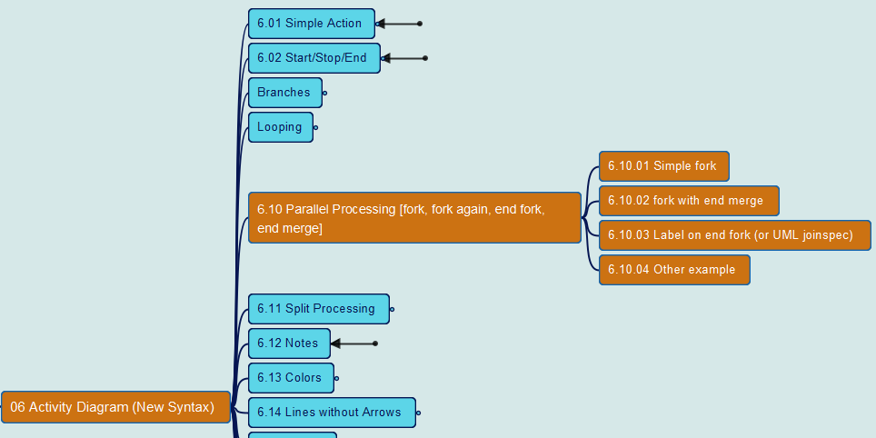
PlantUML in Action
117
6. Activity Diagram (New Syntax)
6.10 Parallel Processing
Yasen – Enterprise Architecture
YouTube: @yasenzhao

Slide 122


PlantUML in Action
118
6. Activity Diagram (New Syntax)
6.11 Split Processing
Yasen – Enterprise Architecture
YouTube: @yasenzhao

Slide 123


PlantUML in Action
119
6. Activity Diagram (New Syntax)
6.12 Notes
Yasen – Enterprise Architecture
YouTube: @yasenzhao

Slide 124


PlantUML in Action
120
6. Activity Diagram (New Syntax)
6.13 Colors
Yasen – Enterprise Architecture
YouTube: @yasenzhao

Slide 125


PlantUML in Action
121
6. Activity Diagram (New Syntax)
6.14 Lines without Arrows
Yasen – Enterprise Architecture
YouTube: @yasenzhao

Slide 126


PlantUML in Action
122
6. Activity Diagram (New Syntax)
6.15 Arrows
Yasen – Enterprise Architecture
YouTube: @yasenzhao

Slide 127
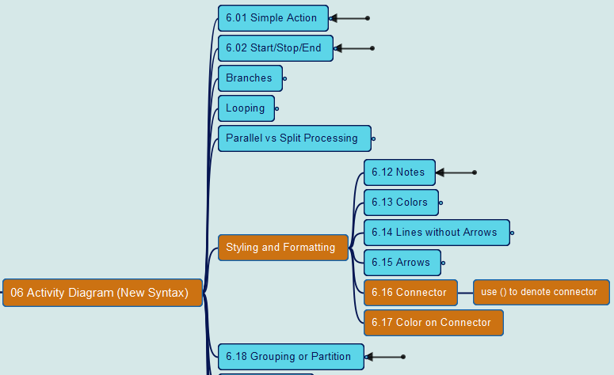
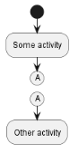
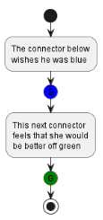
PlantUML in Action
123
6. Activity Diagram (New Syntax)
6.16 Connector 6.17 Color on Connector
Yasen – Enterprise Architecture
YouTube: @yasenzhao

Slide 128
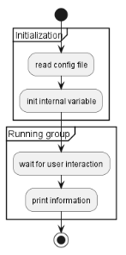
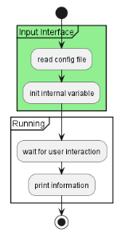
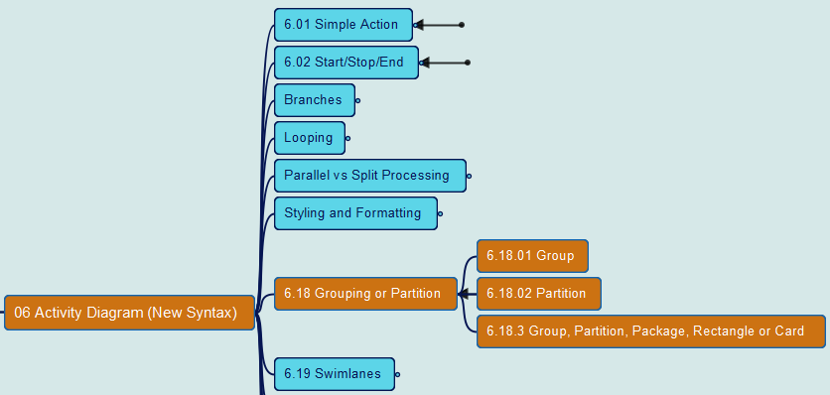
PlantUML in Action
124
6. Activity Diagram (New Syntax)
6.18 Grouping or Partition
Yasen – Enterprise Architecture
YouTube: @yasenzhao

Slide 129
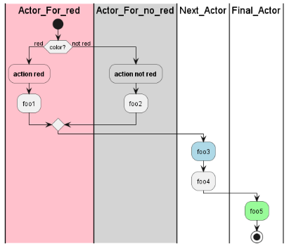
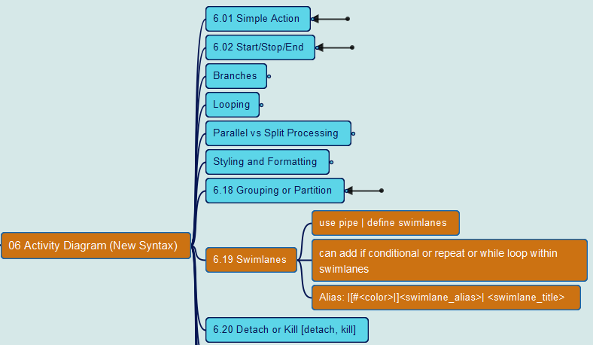
PlantUML in Action
125
6. Activity Diagram (New Syntax)
6.19 Swimlanes
Yasen – Enterprise Architecture
YouTube: @yasenzhao

Slide 130
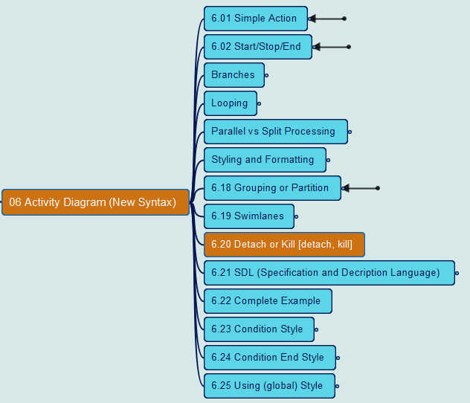
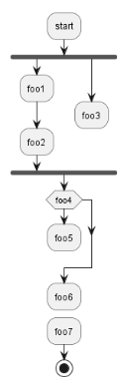
PlantUML in Action
126
6. Activity Diagram (New Syntax)
6.20 Detach or Kill
Yasen – Enterprise Architecture
YouTube: @yasenzhao

Slide 131
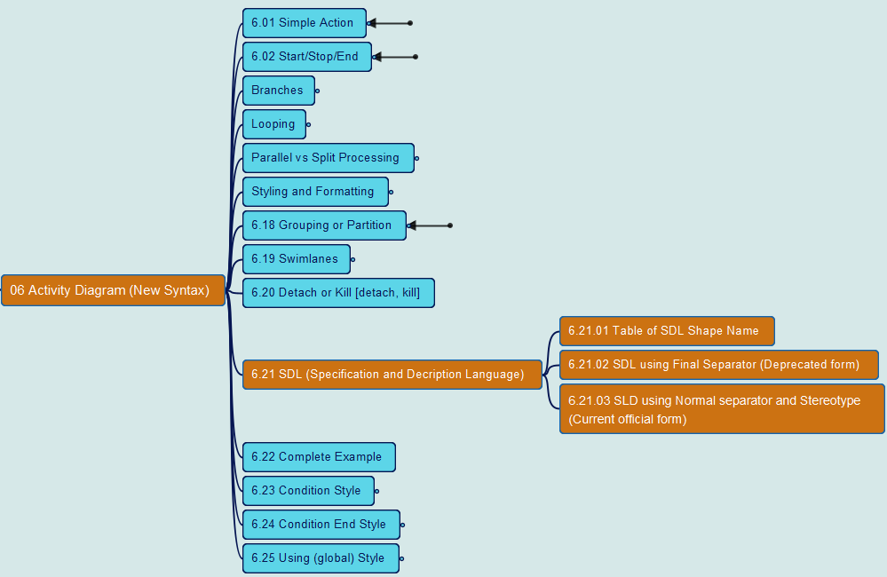
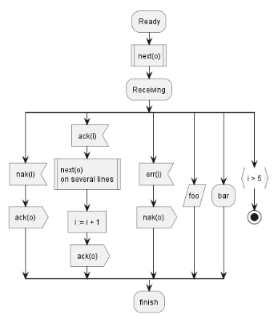
PlantUML in Action
127
6. Activity Diagram (New Syntax)
6.21 SDL (Specification and Description Language)
Yasen – Enterprise Architecture
YouTube: @yasenzhao

Slide 132
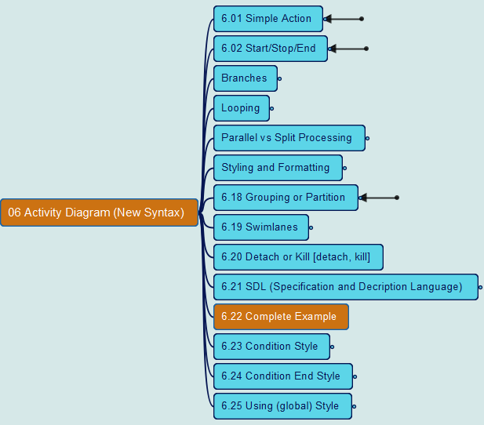
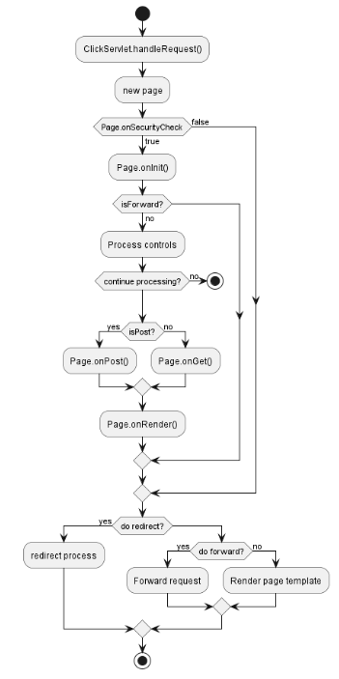
PlantUML in Action
128
6. Activity Diagram (New Syntax)
6.22 Complete Example
Yasen – Enterprise Architecture
YouTube: @yasenzhao

Slide 133
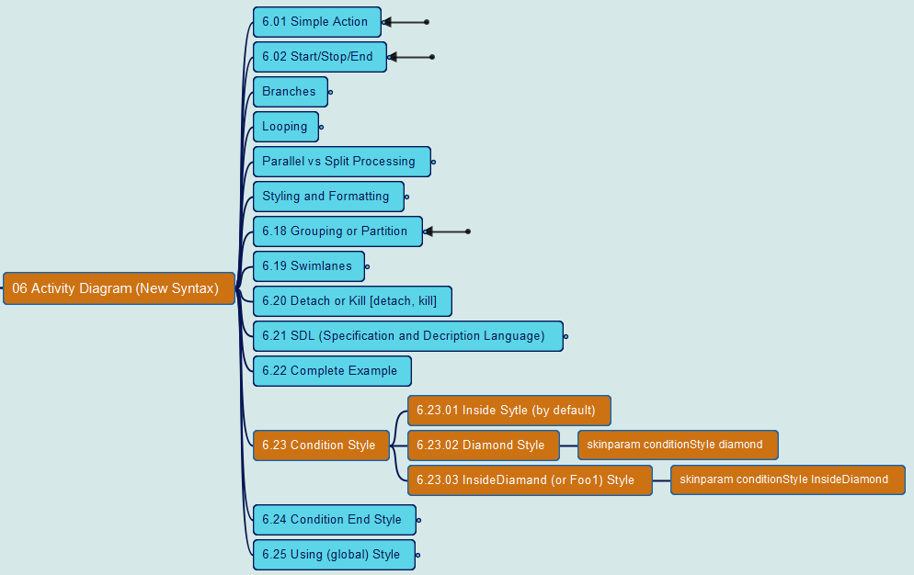
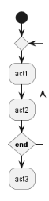
PlantUML in Action
129
6. Activity Diagram (New Syntax)
6.23 Condition Style
Yasen – Enterprise Architecture
YouTube: @yasenzhao

Slide 134
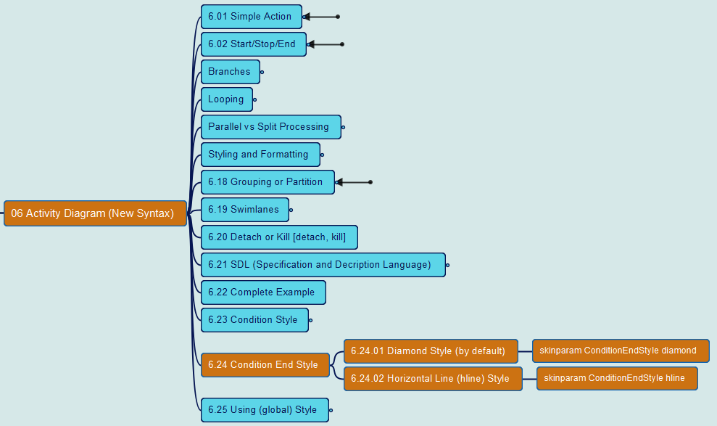
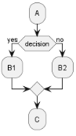
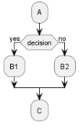
PlantUML in Action
130
6. Activity Diagram (New Syntax)
6.24 Condition End Style
Yasen – Enterprise Architecture
YouTube: @yasenzhao

Slide 135
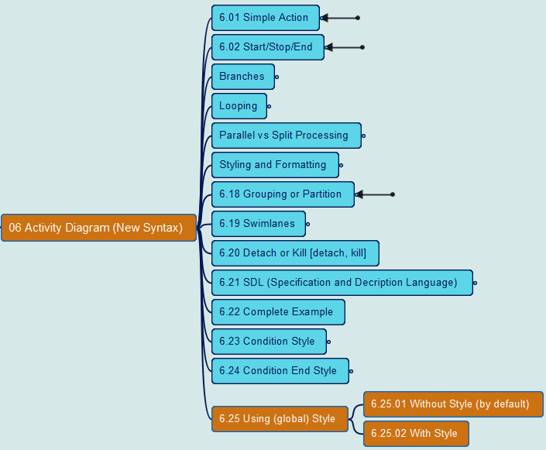
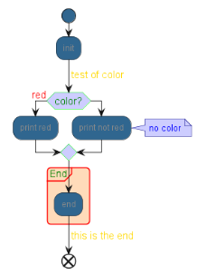
PlantUML in Action
131
6. Activity Diagram (New Syntax)
6.25 Using (global) Style
Yasen – Enterprise Architecture
YouTube: @yasenzhao

Slide 136
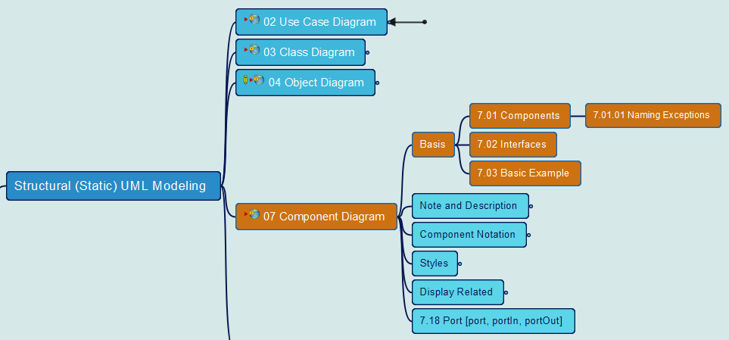
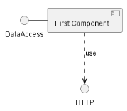
PlantUML in Action
132
7. Component Diagram
7.1 Components 7.2 Interfaces 7.3 Sample
Yasen – Enterprise Architecture
YouTube: @yasenzhao

Slide 137
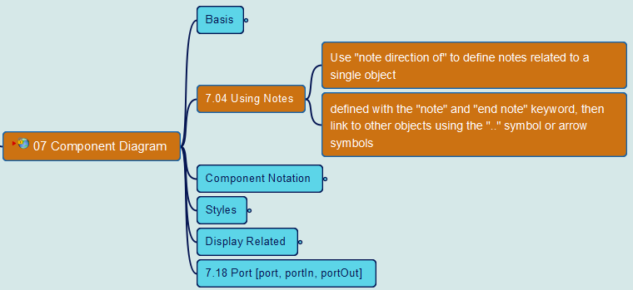
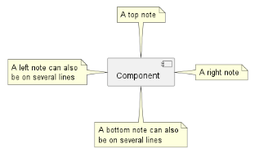
PlantUML in Action
133
7. Component Diagram
7.4 Using Notes
Yasen – Enterprise Architecture
YouTube: @yasenzhao

Slide 138
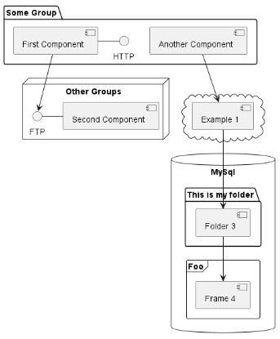
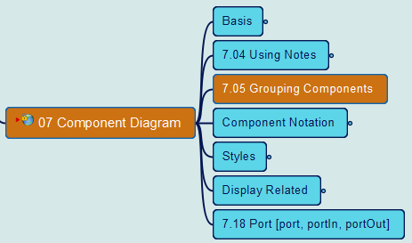
PlantUML in Action
134
7. Component Diagram
7.05 Grouping Components
Yasen – Enterprise Architecture
YouTube: @yasenzhao

Slide 139
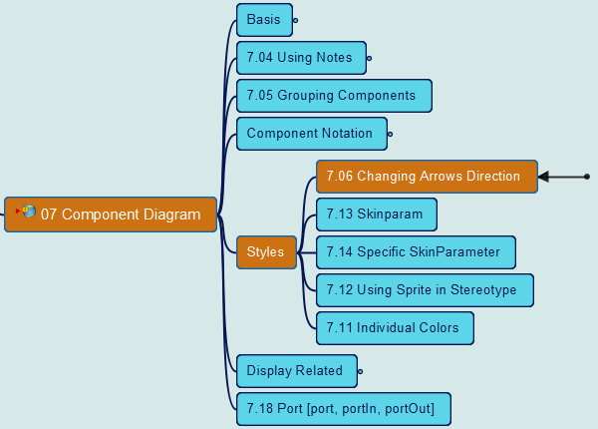
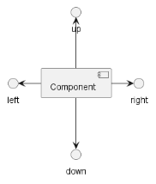
PlantUML in Action
135
7. Component Diagram
7.06 Changing Arrow Direction
Yasen – Enterprise Architecture
YouTube: @yasenzhao

Slide 140
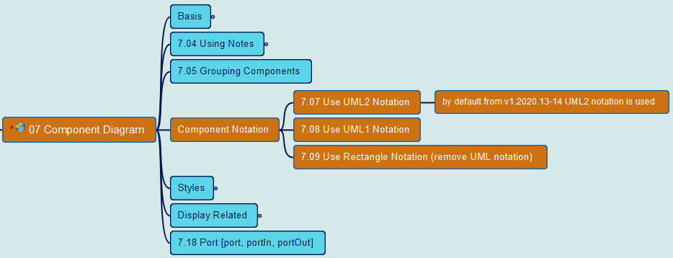
PlantUML in Action
136
7. Component Diagram
7.07/08 Use UML1/2 Notation 7.09 Use Rectangle Notation
Yasen – Enterprise Architecture
YouTube: @yasenzhao

Slide 141
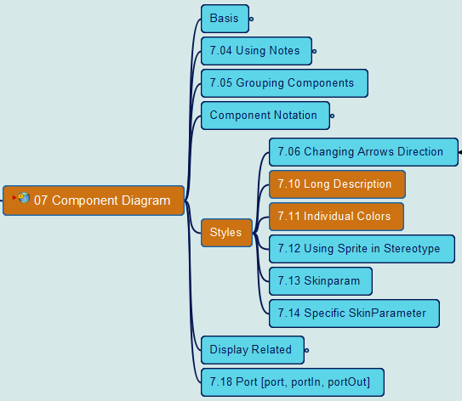
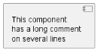
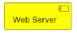
PlantUML in Action
137
7. Component Diagram
7.10 Long Description 7.11 Individual Colors
Yasen – Enterprise Architecture
YouTube: @yasenzhao

Slide 142
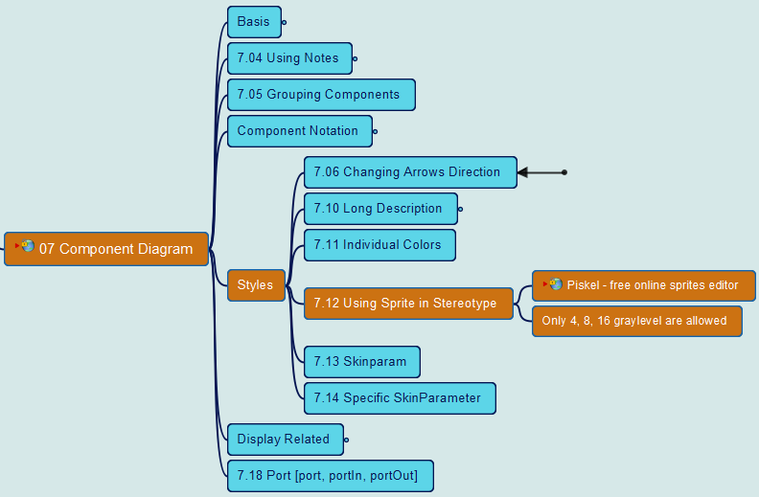
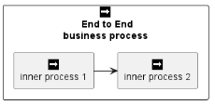
PlantUML in Action
138
7. Component Diagram
7.12 Using Sprite in Stereotype
Yasen – Enterprise Architecture
YouTube: @yasenzhao

Slide 143
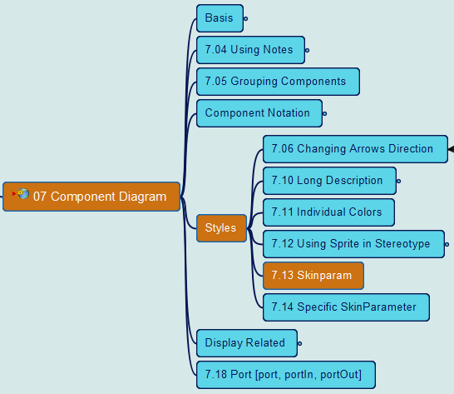
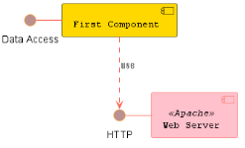
PlantUML in Action
139
7. Component Diagram
7.13 Skinparam
Yasen – Enterprise Architecture
YouTube: @yasenzhao

Slide 144
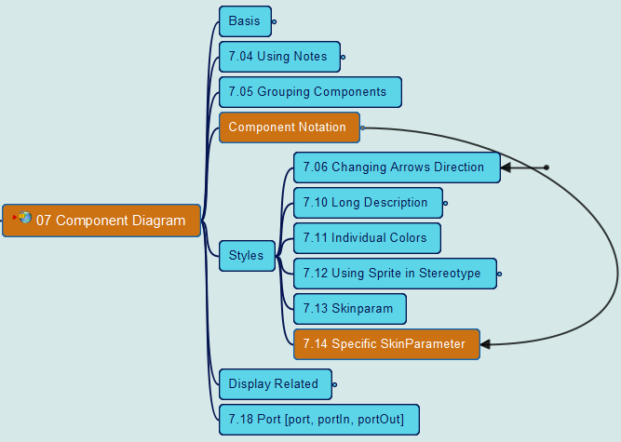
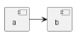
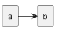
PlantUML in Action
140
7. Component Diagram
7.14 Specific SkinParameter
Yasen – Enterprise Architecture
YouTube: @yasenzhao

Slide 145
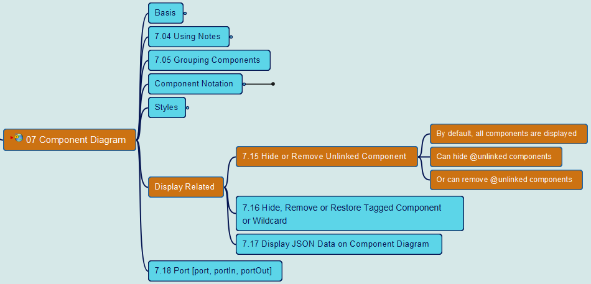
PlantUML in Action
141
7. Component Diagram
7.15 Hide or Remove unlinked component
Yasen – Enterprise Architecture
YouTube: @yasenzhao

Slide 146
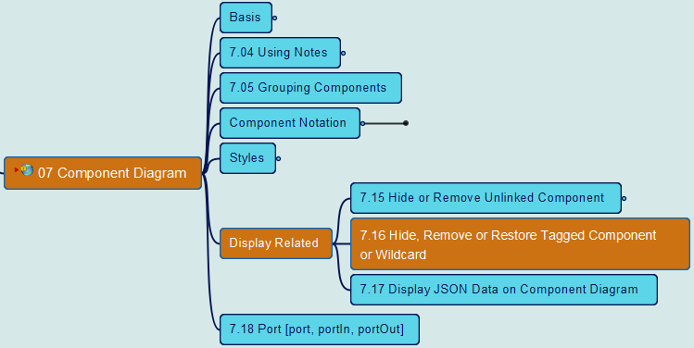
PlantUML in Action
142
7. Component Diagram
7.16 Hide, Remove or Restore tagged component or wildcard
Yasen – Enterprise Architecture
YouTube: @yasenzhao

Slide 147
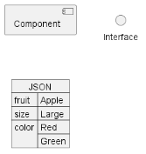
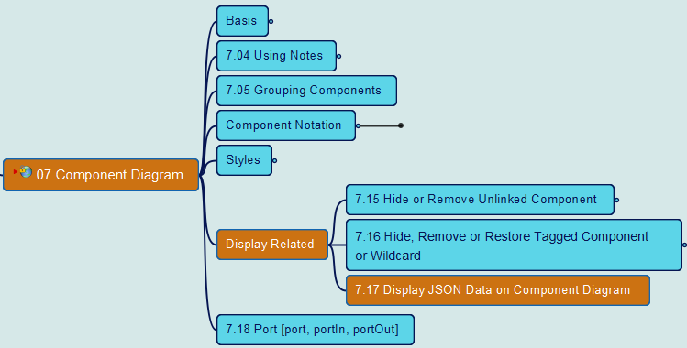
PlantUML in Action
143
7. Component Diagram
7.17 Display JSON Data on Component Diagram
Yasen – Enterprise Architecture
YouTube: @yasenzhao

Slide 148
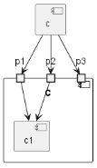
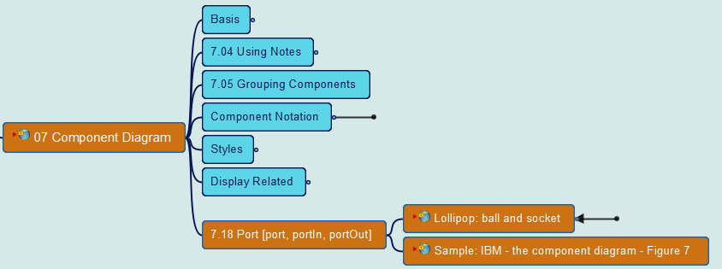
PlantUML in Action
144
7. Component Diagram
7.18-1 Port [port, portIn, portOut]
Yasen – Enterprise Architecture
YouTube: @yasenzhao

Slide 149
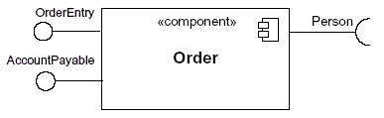
PlantUML in Action
145
7. Component Diagram
7.18-2 Lollipop Notation
Yasen – Enterprise Architecture
YouTube: @yasenzhao

Slide 150
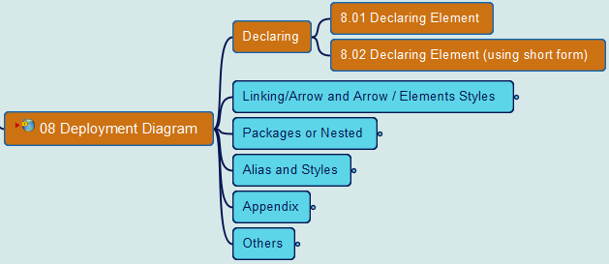

PlantUML in Action
146
8. Deployment Diagram
8.1 & 8.2 Declaring Elements
Yasen – Enterprise Architecture
YouTube: @yasenzhao

Slide 151


PlantUML in Action
147
8. Deployment Diagram
8.3 Linking or Arrow
Yasen – Enterprise Architecture
YouTube: @yasenzhao

Slide 152


PlantUML in Action
148
8. Deployment Diagram
8.4 Bracketed Arrow Style
Yasen – Enterprise Architecture
YouTube: @yasenzhao

Slide 153


PlantUML in Action
149
8. Deployment Diagram
8.5 Change Arrow Color and Style (inline)
Yasen – Enterprise Architecture
YouTube: @yasenzhao

Slide 154


PlantUML in Action
150
8. Deployment Diagram
8.6 Change Element Color and Style (inline)
Yasen – Enterprise Architecture
YouTube: @yasenzhao

Slide 155


PlantUML in Action
151
8. Deployment Diagram
8.7 Nestable Elements 8.8 Packages and Nested Elements
Yasen – Enterprise Architecture
YouTube: @yasenzhao

Slide 156

PlantUML in Action
152
8. Deployment Diagram
8.9 Alias in Deployment Diagram
Yasen – Enterprise Architecture
YouTube: @yasenzhao

Slide 157


PlantUML in Action
153
8. Deployment Diagram
8.10 Round Corner 8.11 Specific SkinParameter
Yasen – Enterprise Architecture
YouTube: @yasenzhao

Slide 158


PlantUML in Action
154
8. Deployment Diagram
8.17 Display JSON Data 8.18 Mixed Deployment
Yasen – Enterprise Architecture
YouTube: @yasenzhao

Slide 159


PlantUML in Action
155
8. Deployment Diagram
8.19 Port [port, portIn, portOut]
Yasen – Enterprise Architecture
YouTube: @yasenzhao

Slide 160


PlantUML in Action
156
9. State Diagram
9.01 Simple State 9.02 Change state rendering
Yasen – Enterprise Architecture
YouTube: @yasenzhao

Slide 161
PlantUML in Action
(source) | State Diagram | Activity Diagram
Purpose | Model reactive systems | Model non-reactive systems
Focus | Internal state of an object or system | Sequence of activities involved in a process or workflow
Elements | States, transitions, events | Activities, actions, transitions
Complexity | More complex | Less complex
Use cases | Embedded systems, control systems, real-time systems | Business processes, workflows, software processes
Yasen – Enterprise Architecture
YouTube: @yasenzhao

Slide 162


PlantUML in Action
157
9. State Diagram
9.03 Composite state
Yasen – Enterprise Architecture
YouTube: @yasenzhao

Slide 163


PlantUML in Action
158
9. State Diagram
9.04 Long name in State Diagram
Yasen – Enterprise Architecture
YouTube: @yasenzhao

Slide 164


PlantUML in Action
159
9. State Diagram
9.05 History [ [H], [H*] ]
Yasen – Enterprise Architecture
YouTube: @yasenzhao

Slide 165


PlantUML in Action
160
9. State Diagram
9.06 Fork [fork, join]
Yasen – Enterprise Architecture
YouTube: @yasenzhao

Slide 166


PlantUML in Action
161
9. State Diagram
9.07 Concurrent State [--, ||]
Yasen – Enterprise Architecture
YouTube: @yasenzhao

Slide 167


PlantUML in Action
162
9. State Diagram
9.08 Conditional [choice]
Yasen – Enterprise Architecture
YouTube: @yasenzhao

Slide 168


PlantUML in Action
163
9. State Diagram
9.09 Stereotypes full example [start, choice, fork, join, end]
Yasen – Enterprise Architecture
YouTube: @yasenzhao

Slide 169


PlantUML in Action
164
9. State Diagram
9.10 Point [entryPoint, exitPoint]
Yasen – Enterprise Architecture
YouTube: @yasenzhao

Slide 170


PlantUML in Action
165
9. State Diagram
9.11 Pin [inputPin, outputPin]
Yasen – Enterprise Architecture
YouTube: @yasenzhao

Slide 171


PlantUML in Action
166
9. State Diagram
9.12 Expansion [expansionInput, expansionOutput]
Yasen – Enterprise Architecture
YouTube: @yasenzhao

Slide 172


PlantUML in Action
167
9. State Diagram
9.13 Arrow direction & 9.14 Change line color and style
Yasen – Enterprise Architecture
YouTube: @yasenzhao

Slide 173


PlantUML in Action
168
9. State Diagram
9.15 Note & 9.16 Note on link & 9.17 More in notes
Yasen – Enterprise Architecture
YouTube: @yasenzhao

Slide 174


PlantUML in Action
169
9. State Diagram
9.18 Inline color
Yasen – Enterprise Architecture
YouTube: @yasenzhao

Slide 175


PlantUML in Action
170
9. State Diagram
9.19 Skinparam
Yasen – Enterprise Architecture
YouTube: @yasenzhao

Slide 176


PlantUML in Action
171
9. State Diagram
9.20 Changing style
Yasen – Enterprise Architecture
YouTube: @yasenzhao

Slide 177


PlantUML in Action
172
9. State Diagram
9.21 Change state color and style (inline style)
Yasen – Enterprise Architecture
YouTube: @yasenzhao

Slide 178


PlantUML in Action
173
9. State Diagram
9.22 Alias & 9.23 Display JSON Data
Yasen – Enterprise Architecture
YouTube: @yasenzhao

Slide 179


PlantUML in Action
174
10. Timing Diagram
10.01 Declaring Element or Participant
Yasen – Enterprise Architecture
YouTube: @yasenzhao

Slide 180


PlantUML in Action
175
10. Timing Diagram
10.02 Binary and Clock
Yasen – Enterprise Architecture
YouTube: @yasenzhao

Slide 181


PlantUML in Action
176
10. Timing Diagram
10.03 Adding Message
Yasen – Enterprise Architecture
YouTube: @yasenzhao

Slide 182


PlantUML in Action
177
10. Timing Diagram
10.04 Relative time
Yasen – Enterprise Architecture
YouTube: @yasenzhao

Slide 183


PlantUML in Action
178
10. Timing Diagram
10.05 Anchor Points
Yasen – Enterprise Architecture
YouTube: @yasenzhao

Slide 184


PlantUML in Action
179
10. Timing Diagram
10.06 Participant oriented
Yasen – Enterprise Architecture
YouTube: @yasenzhao

Slide 185


PlantUML in Action
180
10. Timing Diagram
10.07 Setting scale
Yasen – Enterprise Architecture
YouTube: @yasenzhao

Slide 186


PlantUML in Action
181
10. Timing Diagram
10.08 Initial state
Yasen – Enterprise Architecture
YouTube: @yasenzhao

Slide 187


PlantUML in Action
182
10. Timing Diagram
10.09 Intricated state
Yasen – Enterprise Architecture
YouTube: @yasenzhao

Slide 188


PlantUML in Action
183
10. Timing Diagram
10.10 Hidden state
Yasen – Enterprise Architecture
YouTube: @yasenzhao

Slide 189


PlantUML in Action
184
10. Timing Diagram
10.11 Hide time axis
Yasen – Enterprise Architecture
YouTube: @yasenzhao

Slide 190


PlantUML in Action
185
10. Timing Diagram
10.12 Using Time and Date
Yasen – Enterprise Architecture
YouTube: @yasenzhao

Slide 191


PlantUML in Action
186
10. Timing Diagram
10.13 Adding constraint
Yasen – Enterprise Architecture
YouTube: @yasenzhao

Slide 192


PlantUML in Action
187
10. Timing Diagram
10.14 Highlighted period
Yasen – Enterprise Architecture
YouTube: @yasenzhao

Slide 193


PlantUML in Action
188
10. Timing Diagram
10.15 Using notes
Yasen – Enterprise Architecture
YouTube: @yasenzhao

Slide 194


PlantUML in Action
189
10. Timing Diagram
10.16 Adding texts
Yasen – Enterprise Architecture
YouTube: @yasenzhao

Slide 195


PlantUML in Action
190
10. Timing Diagram
10.17 Complete example
Yasen – Enterprise Architecture
YouTube: @yasenzhao

Slide 196


PlantUML in Action
191
10. Timing Diagram
10.18 Digital Example
Yasen – Enterprise Architecture
YouTube: @yasenzhao

Slide 197


PlantUML in Action
192
10. Timing Diagram
10.19 Adding color
Yasen – Enterprise Architecture
YouTube: @yasenzhao

Slide 198


PlantUML in Action
193
10. Timing Diagram
10.20 Using (global) style
Yasen – Enterprise Architecture
YouTube: @yasenzhao

Slide 199


PlantUML in Action
194
10. Timing Diagram
10.21 Applying Colors to specific lines
Yasen – Enterprise Architecture
YouTube: @yasenzhao

Slide 200


PlantUML in Action
195
10. Timing Diagram
10.22 Compact mode
Yasen – Enterprise Architecture
YouTube: @yasenzhao

Slide 201

PlantUML in Action
196
Opening to the Non-UML diagrams
Yasen – Enterprise Architecture
YouTube: @yasenzhao

Slide 202


PlantUML in Action
197
11. Display JSON Data
11.1 Complex Example
Yasen – Enterprise Architecture
YouTube: @yasenzhao

Slide 203


PlantUML in Action
198
11. Display JSON Data
11.2 Highlight Parts
Yasen – Enterprise Architecture
YouTube: @yasenzhao

Slide 204


PlantUML in Action
199
11. Display JSON Data
11.3 Using Different Styles for Highlight
Yasen – Enterprise Architecture
YouTube: @yasenzhao

Slide 205


PlantUML in Action
200
11. Display JSON Data
11.4 JSON Basic Elements
Yasen – Enterprise Architecture
YouTube: @yasenzhao

Slide 206


PlantUML in Action
201
11. Display JSON Data
11.5 JSON Array or Table
Yasen – Enterprise Architecture
YouTube: @yasenzhao

Slide 207


PlantUML in Action
202
11. Display JSON Data
11.6 JSON Numbers
Yasen – Enterprise Architecture
YouTube: @yasenzhao

Slide 208


PlantUML in Action
203
11. Display JSON Data
11.7 JSON Strings
Yasen – Enterprise Architecture
YouTube: @yasenzhao

Slide 209


PlantUML in Action
204
11. Display JSON Data
11.8 Minimal JSON Examples & 11.9 Empty Table or List
Yasen – Enterprise Architecture
YouTube: @yasenzhao

Slide 210


PlantUML in Action
205
11. Display JSON Data
11.10 Using (Global) Style
Yasen – Enterprise Architecture
YouTube: @yasenzhao

Slide 211


PlantUML in Action
206
11. Display JSON Data
11.11 Display JSON Data on Class or Object Diagram
Yasen – Enterprise Architecture
YouTube: @yasenzhao

Slide 212


PlantUML in Action
207
11. Display JSON Data
11.12 Display JSON Data on Deployment Diagram
Yasen – Enterprise Architecture
YouTube: @yasenzhao

Slide 213


PlantUML in Action
208
11. Display JSON Data
11.13 Display JSON Data on State Diagram
Yasen – Enterprise Architecture
YouTube: @yasenzhao

Slide 214


PlantUML in Action
209
12. Display YAML Data
12.1 Complex Example
Yasen – Enterprise Architecture
YouTube: @yasenzhao

Slide 215


PlantUML in Action
210
12. Display YAML Data
12.2 Specific Key (with symbols or Unicode)
Yasen – Enterprise Architecture
YouTube: @yasenzhao

Slide 216


PlantUML in Action
211
12. Display YAML Data
12.3 Highlight Parts
Yasen – Enterprise Architecture
YouTube: @yasenzhao

Slide 217


PlantUML in Action
212
12. Display YAML Data
12.4 Using Different Styles for Highlight
Yasen – Enterprise Architecture
YouTube: @yasenzhao

Slide 218


PlantUML in Action
213
12. Display YAML Data
12.5 Using (Global) Style
Yasen – Enterprise Architecture
YouTube: @yasenzhao

Slide 219



PlantUML in Action
214
13 Network Diagram (nwdiag)
13.1 Simple Diagram
Yasen – Enterprise Architecture
YouTube: @yasenzhao
Thanks Takeshi Komiya

Slide 220


PlantUML in Action
215
13 Network Diagram (nwdiag)
13.2 Define Multiple Addresses
Yasen – Enterprise Architecture
YouTube: @yasenzhao
Thanks Takeshi Komiya

Slide 221


PlantUML in Action
216
13 Network Diagram (nwdiag)
13.3 Grouping Nodes
Yasen – Enterprise Architecture
YouTube: @yasenzhao
Thanks Takeshi Komiya

Slide 222



PlantUML in Action
217
13 Network Diagram (nwdiag)
13.4 Extended Syntax (for network and group)
Yasen – Enterprise Architecture
YouTube: @yasenzhao
Thanks Takeshi Komiya

Slide 223


PlantUML in Action
218
13 Network Diagram (nwdiag)
13.5 Using Sprites
Yasen – Enterprise Architecture
YouTube: @yasenzhao
Thanks Takeshi Komiya

Slide 224


PlantUML in Action
219
13 Network Diagram (nwdiag)
13.6 Using Open-Iconic
Yasen – Enterprise Architecture
YouTube: @yasenzhao
Thanks Takeshi Komiya

Slide 225


PlantUML in Action
220
13 Network Diagram (nwdiag)
13.7 Same Nodes on More Than Two Networks
Yasen – Enterprise Architecture
YouTube: @yasenzhao
Thanks Takeshi Komiya

Slide 226


PlantUML in Action
221
13 Network Diagram (nwdiag)
13.8 Peer Networks
Yasen – Enterprise Architecture
YouTube: @yasenzhao
Thanks Takeshi Komiya

Slide 227


PlantUML in Action
222
13 Network Diagram (nwdiag)
13.9 Peer Networks and Group
Yasen – Enterprise Architecture
YouTube: @yasenzhao
Thanks Takeshi Komiya

Slide 228


PlantUML in Action
223
13 Network Diagram (nwdiag)
13.10 Add Title, Caption, Header, Footer or Legend
Yasen – Enterprise Architecture
YouTube: @yasenzhao
Thanks Takeshi Komiya

Slide 229


PlantUML in Action
224
13 Network Diagram (nwdiag)
13.11 With or Without Shadow
Yasen – Enterprise Architecture
YouTube: @yasenzhao
Thanks Takeshi Komiya

Slide 230


PlantUML in Action
225
13 Network Diagram (nwdiag)
13.12 Change Width of the Networks
Yasen – Enterprise Architecture
YouTube: @yasenzhao
Thanks Takeshi Komiya

Slide 231


PlantUML in Action
226
13 Network Diagram (nwdiag)
13.13 Other Internal Networks
Yasen – Enterprise Architecture
YouTube: @yasenzhao
Thanks Takeshi Komiya

Slide 232


PlantUML in Action
227
13 Network Diagram (nwdiag)
13.14 Using (global) Style
Yasen – Enterprise Architecture
YouTube: @yasenzhao
Thanks Takeshi Komiya

Slide 233


PlantUML in Action
228
14 Salt (Wireframe)
14.01 Basic Widgets (including Wireframe Basics)
Yasen – Enterprise Architecture
YouTube: @yasenzhao

Slide 234


PlantUML in Action
229
14 Salt (Wireframe)
14.02 Text Area
Yasen – Enterprise Architecture
YouTube: @yasenzhao

Slide 235

PlantUML in Action
230
14 Salt (Wireframe)
14.03 Open, Close Droplist
Yasen – Enterprise Architecture
YouTube: @yasenzhao

Slide 236



PlantUML in Action
231
14 Salt (Wireframe)
14.04 Using Grid [ | and #, !, -, +], 14.05 Group Box [^]
Yasen – Enterprise Architecture
YouTube: @yasenzhao

Slide 237



PlantUML in Action
232
14 Salt (Wireframe)
14.06 Using Separator & 14.07 Tree Widget
Yasen – Enterprise Architecture
YouTube: @yasenzhao

Slide 238


PlantUML in Action
233
14 Salt (Wireframe)
14.08 Tree Table [T]
Yasen – Enterprise Architecture
YouTube: @yasenzhao

Slide 239


PlantUML in Action
234
14 Salt (Wireframe)
14.09 Enclosing Brackets [{, }]
Yasen – Enterprise Architecture
YouTube: @yasenzhao

Slide 240


PlantUML in Action
235
14 Salt (Wireframe)
14.10 Adding Tabs [ / ]
Yasen – Enterprise Architecture
YouTube: @yasenzhao

Slide 241


PlantUML in Action
236
14 Salt (Wireframe)
14.11 Using Menu [ * ]
Yasen – Enterprise Architecture
YouTube: @yasenzhao

Slide 242


PlantUML in Action
237
14 Salt (Wireframe)
14.12 Advanced Table
Yasen – Enterprise Architecture
YouTube: @yasenzhao

Slide 243


PlantUML in Action
238
14 Salt (Wireframe)
14.13 Scroll Bars [S, SI, S-]
Yasen – Enterprise Architecture
YouTube: @yasenzhao

Slide 244


PlantUML in Action
239
14 Salt (Wireframe)
14.14 Colors
Yasen – Enterprise Architecture
YouTube: @yasenzhao

Slide 245


PlantUML in Action
240
14 Salt (Wireframe)
14.15 Creole on Salt (part 1)
Yasen – Enterprise Architecture
YouTube: @yasenzhao

Slide 246
PlantUML in Action
241
14 Salt (Wireframe)
14.15 Creole on Salt (part 2)
Yasen – Enterprise Architecture
YouTube: @yasenzhao

Slide 247


PlantUML in Action
242
14 Salt (Wireframe)
14.16 Pseudo Sprite [ <<, >> ]
Yasen – Enterprise Architecture
YouTube: @yasenzhao

Slide 248


PlantUML in Action
243
14 Salt (Wireframe)
14.17 OpenIconic
Yasen – Enterprise Architecture
YouTube: @yasenzhao

Slide 249


PlantUML in Action
244
14 Salt (Wireframe)
14.18 Add Title, Header, Footer, Captain or Legend
Yasen – Enterprise Architecture
YouTube: @yasenzhao

Slide 250



PlantUML in Action
245
14 Salt (Wireframe)
14.19 Zoom, DPI
Yasen – Enterprise Architecture
YouTube: @yasenzhao

Slide 251


PlantUML in Action
246
14 Salt (Wireframe)
14.20 Include Salt “on activity diagram”
Yasen – Enterprise Architecture
YouTube: @yasenzhao

Slide 252


PlantUML in Action
247
14 Salt (Wireframe)
14.21 Include Salt “on while condition of activity diagram”
Yasen – Enterprise Architecture
YouTube: @yasenzhao

Slide 253


PlantUML in Action
248
14 Salt (Wireframe)
14.22 Include Salt “on repeat while condition of activity diagram”
Yasen – Enterprise Architecture
YouTube: @yasenzhao

Slide 254



PlantUML in Action
249
14 Salt (Wireframe)
14.23 Skinparam (Skin Parameter)
Yasen – Enterprise Architecture
YouTube: @yasenzhao

Slide 255

PlantUML in Action
250
14 Salt (Wireframe)
14.24 Style
Yasen – Enterprise Architecture
YouTube: @yasenzhao

Slide 256



PlantUML in Action
251
15 ArchiMate Diagram
15.01 ArchiMate Keyword
Yasen – Enterprise Architecture
YouTube: @yasenzhao

Slide 257


PlantUML in Action
252
15 ArchiMate Diagram
15.02 Defining Junctions
Yasen – Enterprise Architecture
YouTube: @yasenzhao

Slide 258


PlantUML in Action
253
15 ArchiMate Diagram
15.03 Example 1 (Method 1)
Yasen – Enterprise Architecture
YouTube: @yasenzhao

Slide 259
PlantUML in Action
254
15 ArchiMate Diagram
15.03 Example 1 (Method 2)
Yasen – Enterprise Architecture
YouTube: @yasenzhao

Slide 260


PlantUML in Action
255
15 ArchiMate Diagram
15.04 Example 2 & 15.05 List Possible Sprites
Yasen – Enterprise Architecture
YouTube: @yasenzhao

Slide 261


PlantUML in Action
256
15 ArchiMate Diagram
15.06 ArchiMate Macros
Yasen – Enterprise Architecture
YouTube: @yasenzhao

Slide 262


PlantUML in Action
257
16 GANTT Diagram
16.00 Contents Introduction and Navigation
Yasen – Enterprise Architecture
YouTube: @yasenzhao

Slide 263


PlantUML in Action
258
16 GANTT Diagram
16.01 Declaring Tasks
Yasen – Enterprise Architecture
YouTube: @yasenzhao

Slide 264


PlantUML in Action
259
16 GANTT Diagram
16.02 One-Line Declaration (with “and” conjunction)
Yasen – Enterprise Architecture
YouTube: @yasenzhao

Slide 265


PlantUML in Action
260
16 GANTT Diagram
16.03 Adding Constraints
Yasen – Enterprise Architecture
YouTube: @yasenzhao

Slide 266


PlantUML in Action
261
16 GANTT Diagram
16.04 Short Names
Yasen – Enterprise Architecture
YouTube: @yasenzhao

Slide 267


PlantUML in Action
262
16 GANTT Diagram
16.05 Customize Colors
Yasen – Enterprise Architecture
YouTube: @yasenzhao
GitHub: https://github.com/yasenstar/PlantUML_in_Action
Gitee: https://gitee.com/yasenstar/PlantUML_in_Action

Slide 268


PlantUML in Action
263
16 GANTT Diagram
16.06 Completion Status
Yasen – Enterprise Architecture
YouTube: @yasenzhao

Slide 269


PlantUML in Action
264
16 GANTT Diagram
16.07 Milestone
Yasen – Enterprise Architecture
YouTube: @yasenzhao

Slide 270



PlantUML in Action
265
16 GANTT Diagram
16.08 Hyperlinks & 16.09 Calendar
Yasen – Enterprise Architecture
YouTube: @yasenzhao

Slide 271


PlantUML in Action
266
16 GANTT Diagram
16.10 Coloring Days
Yasen – Enterprise Architecture
YouTube: @yasenzhao

Slide 272


PlantUML in Action
267
16 GANTT Diagram
16.11 Changing Scale (1)
Yasen – Enterprise Architecture
YouTube: @yasenzhao

Slide 273

PlantUML in Action
268
16 GANTT Diagram
16.11 Changing Scale (2)
Yasen – Enterprise Architecture
YouTube: @yasenzhao

Slide 274


PlantUML in Action
269
16 GANTT Diagram
16.12 Zoom (Example for all Scale)
Yasen – Enterprise Architecture
YouTube: @yasenzhao

Slide 275


PlantUML in Action
270
16 GANTT Diagram
16.13 Weekscale with Weeknumbers or Calendar Date
Yasen – Enterprise Architecture
YouTube: @yasenzhao

Slide 276


PlantUML in Action
271
16 GANTT Diagram
16.14 Close Day
Yasen – Enterprise Architecture
YouTube: @yasenzhao

Slide 277


PlantUML in Action
272
16 GANTT Diagram
16.15 Definition of a Week Depending of Closed Days
Yasen – Enterprise Architecture
YouTube: @yasenzhao

Slide 278


PlantUML in Action
273
16 GANTT Diagram
16.16 Working Days
Yasen – Enterprise Architecture
YouTube: @yasenzhao

Slide 279


PlantUML in Action
274
16 GANTT Diagram
16.17 Simplified Task Succession
Yasen – Enterprise Architecture
YouTube: @yasenzhao

Slide 280


PlantUML in Action
275
16 GANTT Diagram
16.18 Working with Resources
Yasen – Enterprise Architecture
YouTube: @yasenzhao

Slide 281



PlantUML in Action
276
16 GANTT Diagram
16.19 Hide Resources
Yasen – Enterprise Architecture
YouTube: @yasenzhao

Slide 282



PlantUML in Action
277
16 GANTT Diagram
16.20 Horizontal Separator & 16.21 Vertical Separator
Yasen – Enterprise Architecture
YouTube: @yasenzhao

Slide 283


PlantUML in Action
278
16 GANTT Diagram
16.22 Complex Example & 16.23 Comments
Yasen – Enterprise Architecture
YouTube: @yasenzhao

Slide 284


PlantUML in Action
279
16 GANTT Diagram
16.24 Using Style – Part 1
Yasen – Enterprise Architecture
YouTube: @yasenzhao

Slide 285

PlantUML in Action
280
16 GANTT Diagram
16.24 Using Style – Part 2
Yasen – Enterprise Architecture
YouTube: @yasenzhao

Slide 286

PlantUML in Action
281
16 GANTT Diagram
16.24 Using Style – Part 3
Yasen – Enterprise Architecture
YouTube: @yasenzhao

Slide 287



PlantUML in Action
282
16 GANTT Diagram
16.25 Add Notes
Yasen – Enterprise Architecture
YouTube: @yasenzhao

Slide 288


PlantUML in Action
283
16 GANTT Diagram
16.26 Pause Tasks
Yasen – Enterprise Architecture
YouTube: @yasenzhao

Slide 289


PlantUML in Action
284
16 GANTT Diagram
16.27 Change Line Color
Yasen – Enterprise Architecture
YouTube: @yasenzhao

Slide 290


PlantUML in Action
285
16 GANTT Diagram
16.28 Tasks or Milestones on the Same Line
Yasen – Enterprise Architecture
YouTube: @yasenzhao

Slide 291


PlantUML in Action
286
16 GANTT Diagram
16.29 Highlight Today
Yasen – Enterprise Architecture
YouTube: @yasenzhao

Slide 292


PlantUML in Action
287
16 GANTT Diagram
16.30 Task between Two Milestones & 16.31 Grammar and Verbal Form
Yasen – Enterprise Architecture
YouTube: @yasenzhao

Slide 293


PlantUML in Action
288
16 GANTT Diagram
16.32 Add Title, Header, Footer, Caption or Legend
Yasen – Enterprise Architecture
YouTube: @yasenzhao

Slide 294


PlantUML in Action
289
16 GANTT Diagram
16.33 Removing Foot Boxes (example for all scale)
Yasen – Enterprise Architecture
YouTube: @yasenzhao

Slide 295


PlantUML in Action
290
16 GANTT Diagram
16.34 Language of the Calendar
Yasen – Enterprise Architecture
YouTube: @yasenzhao

Slide 296


PlantUML in Action
291
16 GANTT Diagram
16.35 Delete Tasks or Milestones
Yasen – Enterprise Architecture
YouTube: @yasenzhao

Slide 297


PlantUML in Action
292
16 GANTT Diagram
16.36 Start a Project, a Task or a Milestone a Number of Days Before or After Today
Yasen – Enterprise Architecture
YouTube: @yasenzhao

Slide 298


PlantUML in Action
293
16 GANTT Diagram
16.37 Change Label Position
Yasen – Enterprise Architecture
YouTube: @yasenzhao

Slide 299


PlantUML in Action
294
17 Mindmap
17.01 OrgMode Syntax

Slide 300


PlantUML in Action
295
17 Mindmap
17.02 Markdown Syntax

Slide 301


PlantUML in Action
296
17 Mindmap
17.03 Arithmetic Notation

Slide 302


PlantUML in Action
297
17 Mindmap
17.04 Multi-lines

Slide 303


PlantUML in Action
298
17 Mindmap
17.05 Multiroot Mindmap

Slide 304


PlantUML in Action
299
17 Mindmap
17.06 Colors – Part 1 – with Inline color

Slide 305
PlantUML in Action
300
17 Mindmap
17.06 Colors – Part 2 – with Style color

Slide 306


PlantUML in Action
301
17 Mindmap
17.07 Removing Box

Slide 307


PlantUML in Action
302
17 Mindmap
17.08 Changing Diagram Direction

Slide 308


PlantUML in Action
303
17 Mindmap
17.09 Complete Example

Slide 309


PlantUML in Action
304
17 Mindmap
17.10 Changing Style

Slide 310


PlantUML in Action
305
17 Mindmap
17.11 Word Wrap

Slide 311


PlantUML in Action
306
17 Mindmap
17.12 Creole on Mindmap Diagram

Slide 312


PlantUML in Action
307
18 Work Breakdown Structure (WBS)
18.01 OrgMode Syntax

Slide 313


PlantUML in Action
308
18 Work Breakdown Structure (WBS)
18.02 Change Direction

Slide 314


PlantUML in Action
309
18 Work Breakdown Structure (WBS)
18.03 Arithmetic Notation

Slide 315


PlantUML in Action
310
18 Work Breakdown Structure (WBS)
18.04 MultiLines

Slide 316


PlantUML in Action
311
18 Work Breakdown Structure (WBS)
18.05 Removing Box

Slide 317


PlantUML in Action
312
18 Work Breakdown Structure (WBS)
18.06 Color (with Inline or Style Color)

Slide 318


PlantUML in Action
313
18 Work Breakdown Structure (WBS)
18.07 Using Style

Slide 319


PlantUML in Action
314
18 Work Breakdown Structure (WBS)
18.08 Word Wrap

Slide 320


PlantUML in Action
315
18 Work Breakdown Structure (WBS)
18.09 Add Arrows between WBS Elements

Slide 321


PlantUML in Action
316
18 Work Breakdown Structure (WBS)
18.10 Creole on WBS Diagram

Slide 322


PlantUML in Action
317
19 Maths
19.0.1 AsciiMath Notation

Slide 323

PlantUML in Action
318
19 Maths
19.0.1 JLaTeXMath Notation

Slide 324


PlantUML in Action
319
19 Maths
19.1 Standalone Diagram on Maths

Slide 325


PlantUML in Action
320
20 Entity Relationship Diagram
20.1 Information Engineering Relations & 20.2 Entities

Slide 326


PlantUML in Action
321
20 Entity Relationship Diagram
20.3 Complete Example

